Slide 1
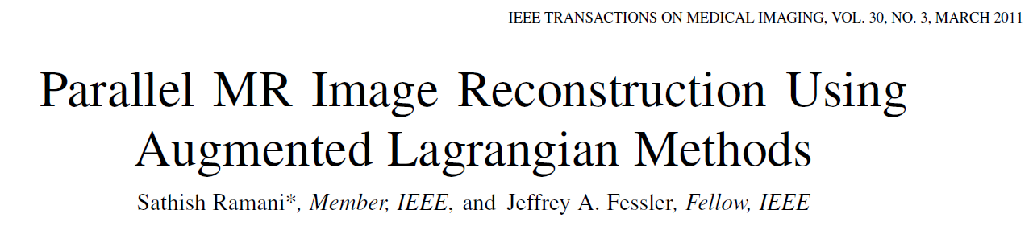

Slide 2
Abstract
SENSE needs regularization to noise and aliasing suppression
Ex. Edge preserving, sparsity-based regularization
-> computationally intensive(non-linear optimization)
Augmented Lagrangian (AL) framework
- for solving large-scale constrained optimization problems.
1. Formulate regularized SENSE as an unconstrained optimization task.
2. Convert it to a set of constrained problems using variable splitting.
3. Solve it using alternating minimization method.
AL algorithms converge faster than general-purpose optimization algorithms (NCG, MFISTA)

Slide 3
1. Introduction
2. Problem Formulation (P0)
3. Constrained Optimization and Augmented Lagrangian (AL) Formalism
4. Proposed AL Algorithms for Regularized SENSE-Reconstruction
4.1. Splitting the regularization term (P1)
4.2. Splitting the Fourier Encoding and Spatial Components in the Data-Fidelity Term

Slide 4
1.
Introduction

Slide 5
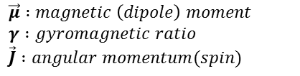
1. Introduction
SENSE is a pMRI technique where reconstruction is performed by solving a linear system that explicitly depends on the sensitivity maps.
However, reconstruction inherently suffer from SNR degradation in the presence of noise mainly due to k-space undersampling and instability arising from correlation in sensitivity maps.
$\vec{μ} :magnetic \left(dipole\right) moment$
$γ :gyromagnetic ratio$
$\vec{J} :angular momentum(spin)$
Regularization is an attractive means of restoring stability where prior information can also be incorporated effectively.
We formulate regularized SENSE-reconstruction as an unconstrained optimization problem.

Slide 6
1. Introduction
This paper presents accelerated algorithms for
regularized SENSE-reconstruction using the augmented Lagrangian (AL) formalism.
To use the AL formalism, we first convert the unconstrained problem in to an equivalent constrained optimization problem using a technique called variable splitting where auxiliary variables take the place of linear transformations of X in the cost function J.
$\vec{μ} :magnetic \left(dipole\right) moment$
$γ :gyromagnetic ratio$
$\vec{J} :angular momentum(spin)$
Then, we construct a corresponding AL function and minimize it alternatively with respect to one auxiliary variable at a time—this step forms the key ingredient as it decouples the minimization process and simplifies optimization
We also propose to use a diagonal weighting term in the AL formalism to induce suitable balance between various constraints because the matrix-elements associated with Fourier encoding and the sensitivity maps can be of different orders of magnitude in SENSE.
\

Slide 7
2.
Problem formulation
Section II formulates the regularized SENSE-reconstruction problem
(with sparsity-based regularization) as an unconstrained optimization task.

Slide 8




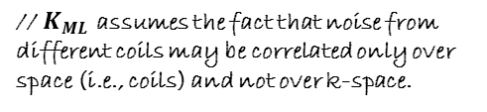

2. Problem Formulation
$x :unknown image to be reconstructed$
$[N X 1]$
SENSE MR imaging model :
$d :sampling data(kspace)$
$[ML X 1]$
$ε :noise$
$[ML X 1]$
$S :sensitivity map$
$$\left[NL X N\right], S=\left[S_{1};…;S_{L}\right], S_{l}:\left[N X N\right] diagonal matrix$$
$F :FourierUndersampling encoding matrix$
$\left[ML X NL\right], F=I_{L}ⓧF_{u}, F_{u}:\left[M X N\right] Fourier encoding matrix, I_{L}:identity matrix of size L$
Since regularization is able to reducing aliasing artifacts and the effect of noise(by incorporating prior knowledge), we formulate the problem in a penalized-likelihood setting and solve it by minimizing a cost criterion
$\vec{μ} :magnetic \left(dipole\right) moment$
$γ :gyromagnetic ratio$
$\vec{J} :angular momentum(spin)$
$K_{ML} :inverse of the noise covariance matrix$
$\left[ML X ML\right], K_{ML}=K_{S}ⓧI_{M}, K_{S} :\left[L X L\right] inverse of the covariance matrix from L coils ; {\left|\left|u\right|\right|}_{K}^{2}=u^{H}Ku$
The weighting matrix $K_{ML}$ can be eliminated from cost function by applying a noise-decorrelation procedure.
// $K_{ML}$ assumes the fact that noise from different coils may be correlated only over space (i.e., coils) and not over k-space.

Slide 9






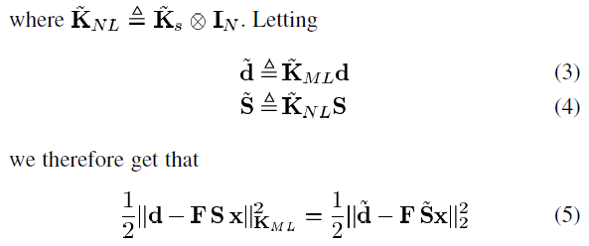
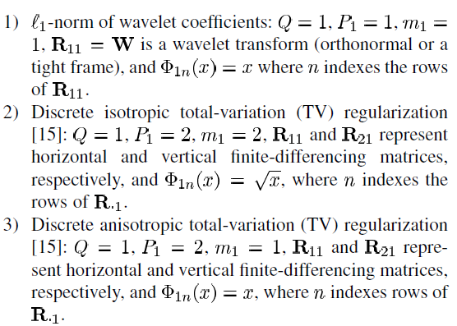



2. Problem Formulation
①
②
① : Noise decorrelation
② : General expression of regularizor
// Cholesky decomposition
$\vec{μ} :magnetic \left(dipole\right) moment$
$γ :gyromagnetic ratio$
$\vec{J} :angular momentum(spin)$
// ${\left(AⓧB\right)}^{H}=(A^{H}\text{ⓧ}B^{H})$
$q →regularizer$
$p →regularizer^{′}s subordinate matrix$ (property)
$Φ→some operator which complete the regularizer$
//$\left(AⓧB\right)\left(CⓧD\right)=(AC)ⓧ(BD)$
Examples)
https://www.hindawi.com/journals/jam/2013/296185/

Slide 10

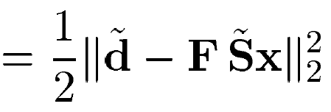

2. Problem Formulation
$\vec{μ} :magnetic \left(dipole\right) moment$
$γ :gyromagnetic ratio$
$\vec{J} :angular momentum(spin)$
The basic idea is to break down P0 in to smaller tasks by introducing “artificial” constraints that are designed so that the subproblems become decoupled and can be solved relatively rapidly.

Slide 11
3.
Constrained Optimization and Augmented Lagrangian (AL) Formalism
Section III presents a quick overview of AL framework.

Slide 12








3. Constrained Optimization and Augmented Lagrangian (AL) Formalism
Constrained optimization problem
Augmented Lagrangian function (Unconstrained optimization)
// Augmented(penalty) term
- Solver : alternative minimization w.r.t. $u$ for a fixed $μ$(penalty weight) and updating $γ$(Lagrange factor)
An important aspect of the AL scheme is that convergence may be guaranteed without the need for changing $μ$

Slide 13


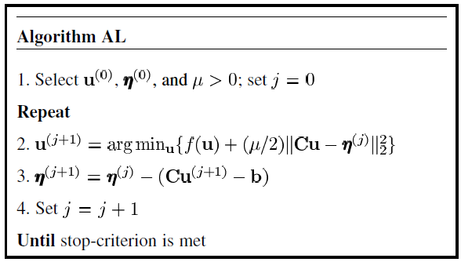
3. Constrained Optimization and Augmented Lagrangian (AL) Formalism
The AL function L can be rewritten by grouping together the terms involving $Cu−b$ as
$\vec{μ} :magnetic \left(dipole\right) moment$
$γ :gyromagnetic ratio$
$\vec{J} :angular momentum(spin)$

Slide 14


3. Constrained Optimization and Augmented Lagrangian (AL) Formalism
Bregman iterations
// Bregman distance
If $ρ=−C^{H}γ$ then, $D_{f}\left(u,u^{\left(j\right)},ρ^{\left(j\right)}\right)+\frac{μ}{2}{\left|\left|Cu−b\right|\right|}_{2}^{2}$ is identical to $￡(u,γ^{\left(j\right)},μ)$
$\vec{μ} :magnetic \left(dipole\right) moment$
$γ :gyromagnetic ratio$
$\vec{J} :angular momentum(spin)$
// up to constants irrelevant for optimization
The Bregman iterations converge exactly under mentioned condition
-> Step 2 of the AL algorithm will use this property
However, this step may be computationally expensive and is often replaced by an inexact minimization.
Numerical evidence suggests that inexact minimizations can still be effective in the Bregman/AL scheme.

Slide 15
4.
Proposed AL Algorithms for Regularized SENSE-Reconstruction
// How to solve this part?
Section IV applies the AL formalism to regularized SENSE-reconstruction in detail.

Slide 16



4. Proposed AL Algorithms for Regularized SENSE-Reconstruction
Variable Splitting with auxiliary variables
Unconstrained problem :
$\vec{μ} :magnetic \left(dipole\right) moment$
$γ :gyromagnetic ratio$
$\vec{J} :angular momentum(spin)$
Auxiliary variable
Constrained problem :
In this paper,
$f_{1}\left(u\right)+f_{2}\left(g\left(u\right)\right)=P0$
$g\left(u\right) :linear transformation(FSx, Rx)$
Manya V. Afonso, “Fast Image Recovery Using Variable Splitting and Constrained Optimizatio”, IEEE Transactions on Image Processing, 2009.

Slide 17
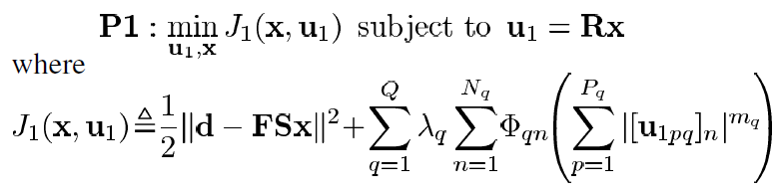




4.1. Splitting the Regularization Term
The resulting constrained formulation of P0 is
$\vec{μ} :magnetic \left(dipole\right) moment$
$γ :gyromagnetic ratio$
$\vec{J} :angular momentum(spin)$
In AL framework,
After ignoring irrelevant constants,

Slide 18
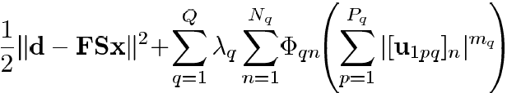


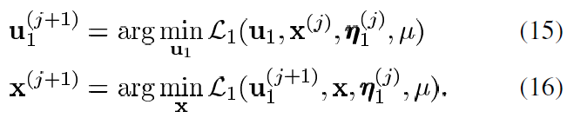
4.1. Splitting the Regularization Term
Cf)
Solve it by using alternative minimization method
$\vec{μ} :magnetic \left(dipole\right) moment$
$γ :gyromagnetic ratio$
$\vec{J} :angular momentum(spin)$
1) Minimization w.r.t. $x$
// eq. 16
2) Minimization w.r.t. $u_{1}$
// eq. 15

Slide 19

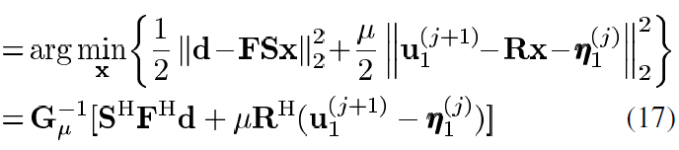


4.1. Splitting the Regularization Term
Cf)
Minimization w.r.t. $x$
// constants are omitted
$\vec{μ} :magnetic \left(dipole\right) moment$
$γ :gyromagnetic ratio$
$\vec{J} :angular momentum(spin)$
Computing $G_{μ}^{−1}$ is impractical for large N.
Therefore, few iterations of CG algorithm will be applied (CG is precalculated before AL iteration)
// no iteration affected variables in G^-1

Slide 20

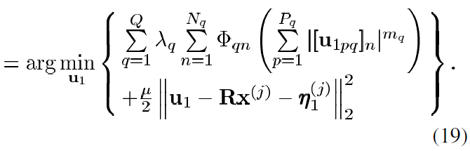
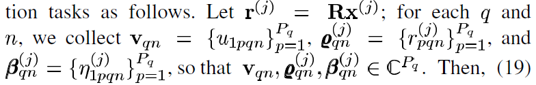
4.1. Splitting the Regularization Term
Cf)
Minimization w.r.t. $u_{1}$
// constants are omitted
$\vec{μ} :magnetic \left(dipole\right) moment$
$γ :gyromagnetic ratio$
$\vec{J} :angular momentum(spin)$
Let’s decompose this large-scale problem into smaller minimization tasks

Slide 21
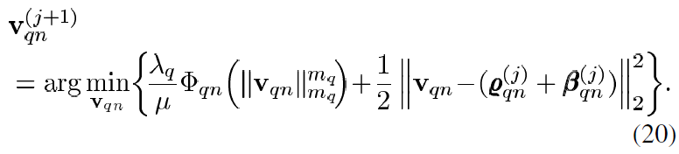

4.1. Splitting the Regularization Term
Minimization w.r.t. $u_{1}$
$\vec{μ} :magnetic \left(dipole\right) moment$
$γ :gyromagnetic ratio$
$\vec{J} :angular momentum(spin)$
Gradient :
The main obstacles to obtaining a direct solution of (20) are the coupling introduced between different components of v [$Φ′({\left|\left|v\right|\right|}_{m}^{m})$ and the presence of the ${\left|v_{k}\right|}^{m−2}$ in $Θ(v)$].

Slide 22


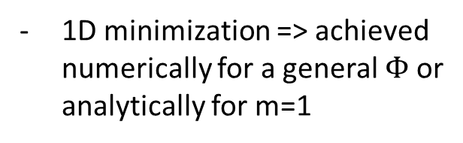

4.1. Splitting the Regularization Term
The main obstacles can be circumvented and here’s some cases
1) l1-regularization
2) P=1
// P : size of ‘v’
- m=1, $Φ\left(x\right)=x$
1D minimization => achieved numerically for a general $Φ$or analytically for m=1
$\vec{μ} :magnetic \left(dipole\right) moment$
$γ :gyromagnetic ratio$
$\vec{J} :angular momentum(spin)$
Gradient :
By shrinkage rule,

Slide 23
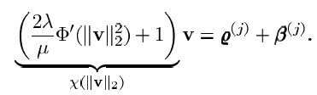





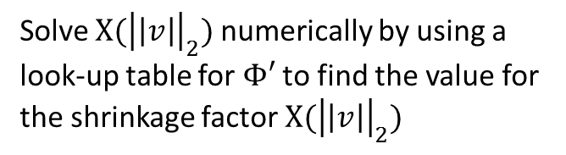
4.1. Splitting the Regularization Term
The main obstacles can be circumvented and here’s some cases
3) m=2 and A general $Φ$
4) TV-type regularization
- m=2, $Φ\left(x\right)=\sqrt{x}$
Gradient :
Gradient :
$\vec{μ} :magnetic \left(dipole\right) moment$
$γ :gyromagnetic ratio$
$\vec{J} :angular momentum(spin)$
Solve $Χ({\left|\left|v\right|\right|}_{2})$ numerically by using a look-up table for $Φ′$ to find the value for the shrinkage factor $Χ({\left|\left|v\right|\right|}_{2})$
Taking l2-nrom on both sides and manipulating,
By shrinkage rule,
In summary, the minimization problem(20) is fairly simple and fast typically.
Possible to derive closed-form solution ->

Slide 24
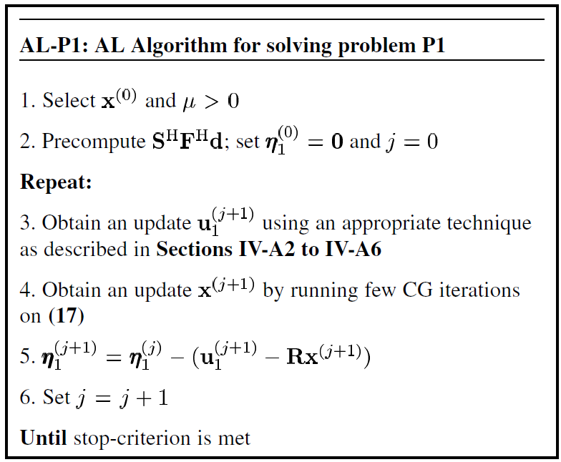
4.1. Splitting the Regularization Term
AL algorithm for problem P1
$\vec{μ} :magnetic \left(dipole\right) moment$
$γ :gyromagnetic ratio$
$\vec{J} :angular momentum(spin)$
// cases being shown
// most complex part(CG)

Slide 25
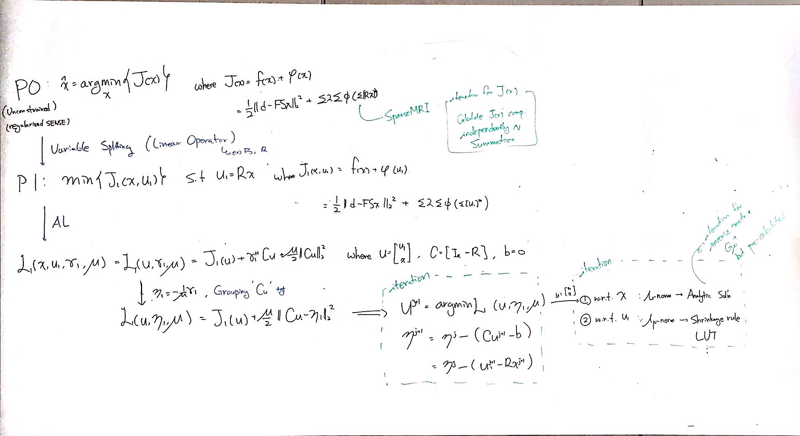
4.1. Splitting the Regularization Term
The main obstacles can be circumvented and here’s some cases
Lagrange multiplier method
AL
penalty

Slide 26
4.
Proposed AL Algorithms for Regularized SENSE-Reconstruction
Section IV applies the AL formalism to
regularized SENSE-reconstruction in detail.
Section V is dedicated to numerical experiments and results.
Section VI discusses possible extensions of the proposed AL
methods to handle some variations of SENSE-reconstruction
such as that proposed in [14].

